Slide 1

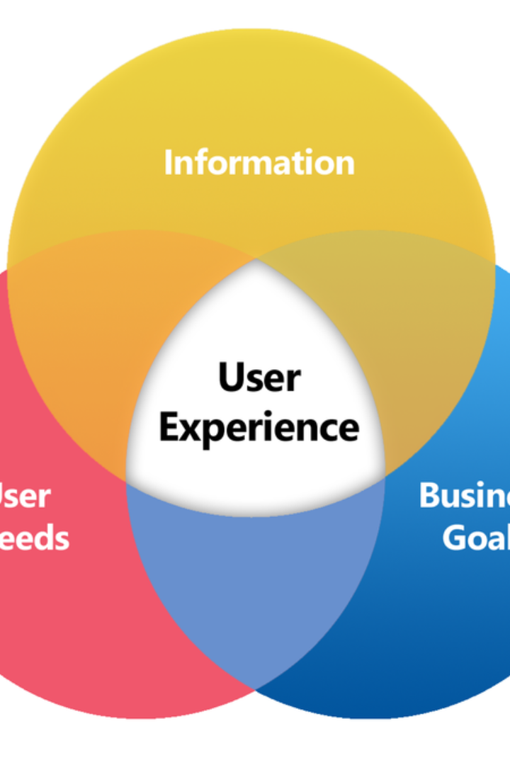
Introduction to User Experience Assessment
This section provides an overview of the importance of user experience assessment and its impact on product development and customer satisfaction.

Slide 2
Overview of Test Case: Evaluate the impact of catalog scoring on overall user experience within Buyer Apps
Understanding Catalog Scoring
Impact of Catalog Scoring
Assessment Objectives
Catalog scoring refers to the system used to rate or grade the products or items within the buyer app's catalog. It is crucial as it directly impacts how products are displayed to users and can influence their decision-making process.
The evaluation aims to understand how catalog scoring affects the overall user experience within the buyer apps. It will analyze whether higher-rated products result in more customer engagement and satisfaction.
The assessment will focus on identifying any potential issues with the current catalog scoring system and propose improvements to enhance the user experience and boost overall customer satisfaction.

Slide 3
Explanation of Catalog Scoring and Its Relevance to User Experience
1
Scoring Algorithm
2
User Interaction
3
Visual Presentation
An analysis of how users perceive and interact with products based on their scores, including the psychological aspects of decision-making.
The detailed algorithm used for catalog scoring will be explained, including the factors and weight assigned to each aspect of the products or items.
The presentation of scored products and how it influences user behavior and overall experience on the buyer apps platform.

Slide 4
Methodology for Collecting User Data
1
2
Data Collection
Sample Size
Detailing the process and tools used for gathering user data, including surveys, heatmaps, and user behavior analytics.
Explaining the considerations for determining the sample size of users for an accurate assessment of the buyer apps' user experience.

Slide 5
Analysis of User Data and Its Impact on Overall User Experience
Demographic Analysis
Behavioral Patterns
User Feedback
Identifying user demographics and their interaction with the catalog scoring system.
Analyzing patterns in product engagement, such as view time and click-through rates.
Evaluating user feedback on the existing catalog scoring and its impact on their overall experience.

Slide 6




Key Findings and Insights
Data Patterns
User Preferences
Behavioral Shifts
Identifying trends and correlations within the collected user data to derive key insights.
Understanding the preferences of users in relation to catalog scoring and their impact on the overall user experience.
Highlighting any significant shifts or changes in user behavior in response to different catalog scoring methods.

Slide 7

Recommendations for Improving Catalog Scoring and Enhancing User Experience
User-Centric Approach
Visual Presentation Enhancement
Data-Driven Iterations
Suggesting the adoption of a more user-centric catalog scoring system, considering user preferences and behavior.
Recommendations for iterative changes based on user data analysis to improve catalog scoring and overall user experience.
Proposing improvements in the presentation and visualization of scored products for a more engaging and intuitive user experience.

Slide 8

Conclusion and Next Steps
Conclusion
1
Summarizing the key findings and recommendations from the user experience assessment of catalog scoring within Buyer Apps.
2
Implementation Plan
Outlining the steps for implementing the proposed improvements and the timeline for assessing their impact.

